Slide 1
QXtend Inbound

Slide 2
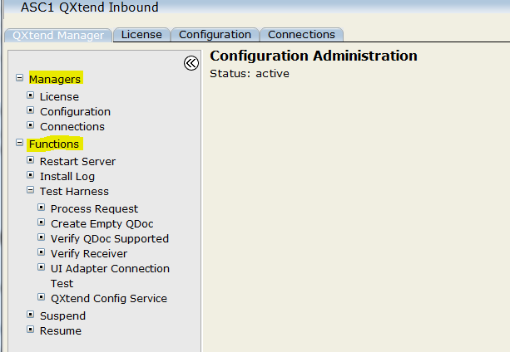
QXtend Inbound

Slide 3
MANAGERS
License
Configuration
Connections

Slide 4
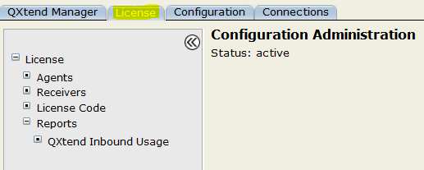
License
QXtend needs license code to communicate with third party products.
Agents
Receivers
license code
reports

Slide 5
Agents
Agents move data into and out of the system. Agents listen for requests to transmit data, gather the data to transmit, and deliver it to the receiver.

Slide 6
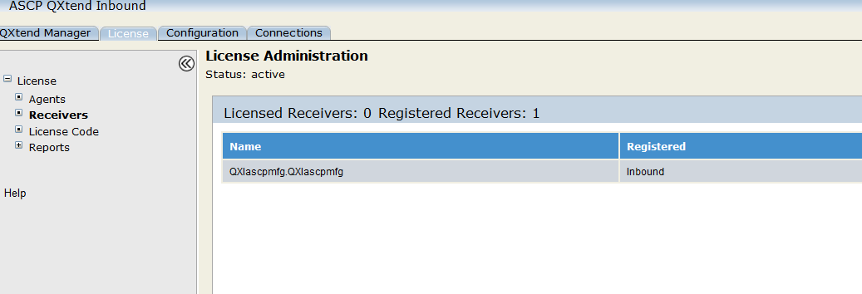
Receivers
A receiver is a destination or endpoint for data transmitted via QXtend.

Slide 7
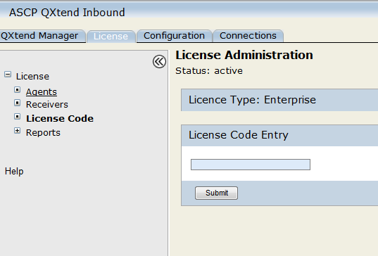
license code
This allows you to enter license codes for valid user types, such as MFG/PRO.

Slide 8
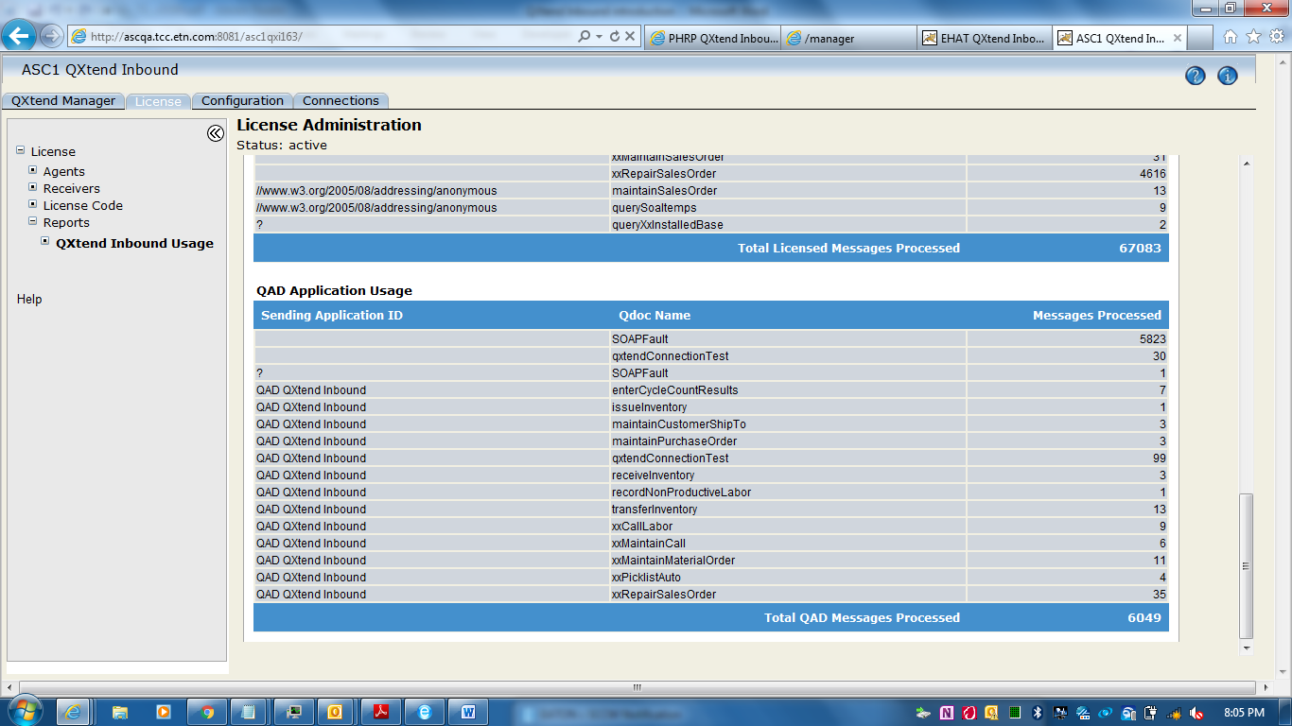
reports

Slide 9
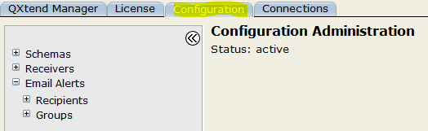
Configuration
To ensure that messages can be processed into a target QAD application
schemas
Receivers
Email alerts

Slide 10
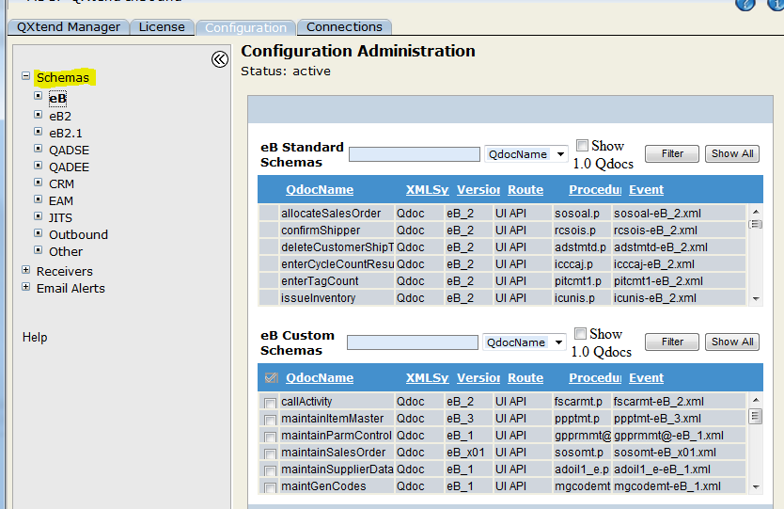
SCHEMA

Slide 11
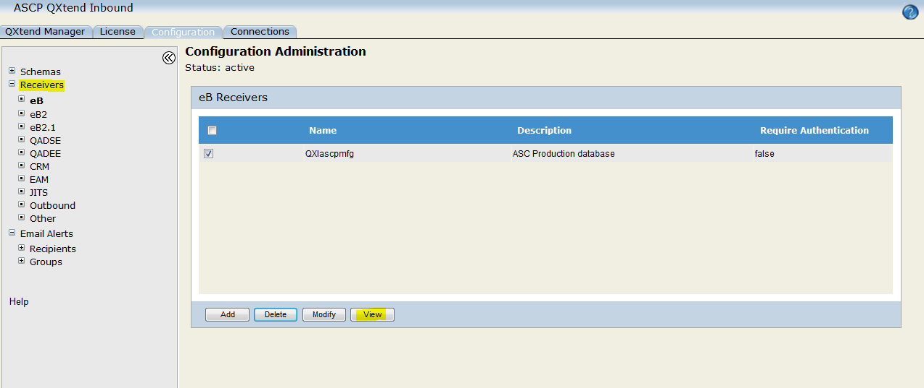
Receivers

Slide 12
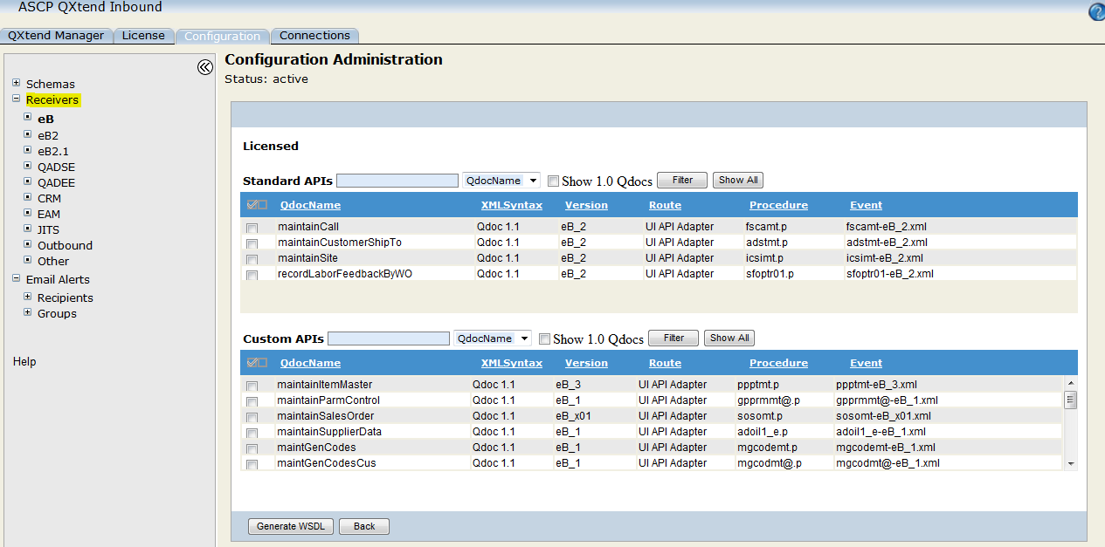
Clicking view
Click on Generate WSDL to get wsdl, xsd files

Slide 13
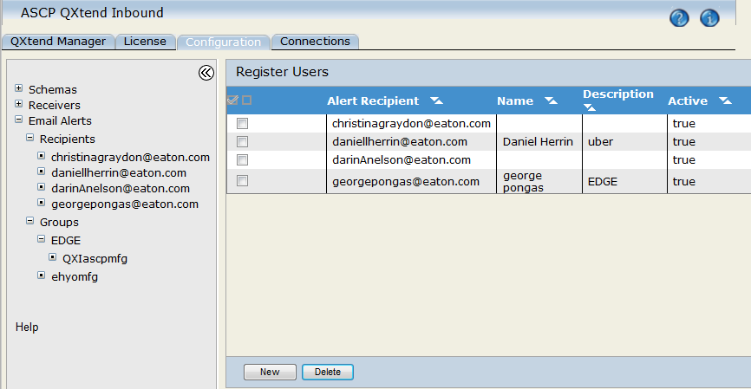
Email alerts
Recipients

Slide 14
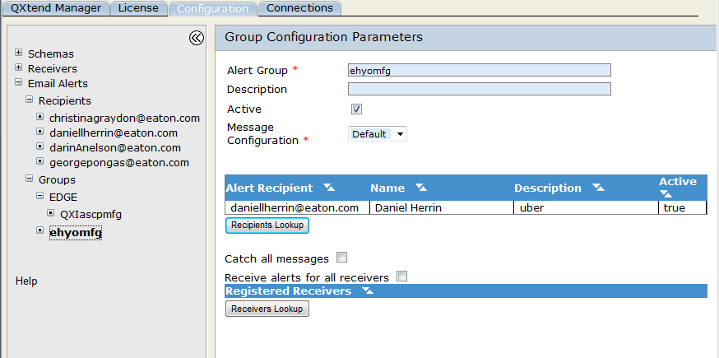
Email alerts
Groups

Slide 15
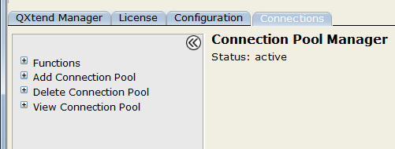
Connections
QXI connection pools provide connections from QXtend to specific instances of QAD applications
+ Functions + Add connection pool
+ Delete connection pool + view connection pool

Slide 16
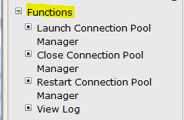
Functions
Launch connection pool manager
Close connection Pool manager
Restart connection Pool manager
View log

Slide 17
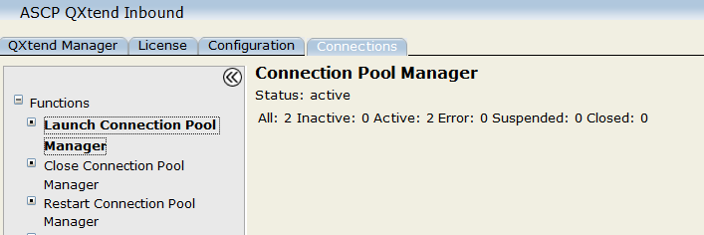
Launch connection pool manager

Slide 18
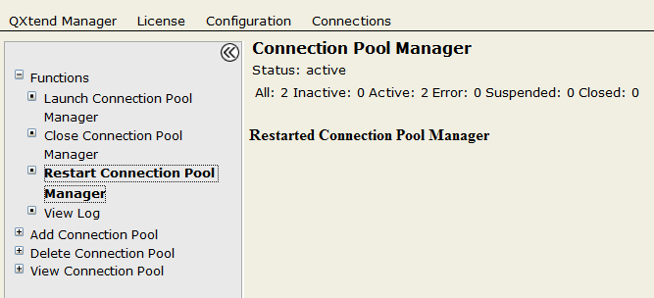
Restart connection Pool manager

Slide 19
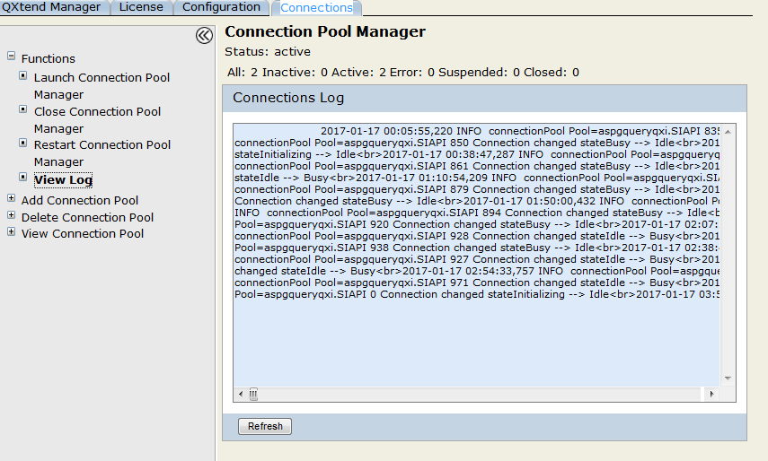
View log

Slide 20
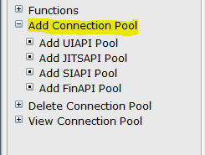
Add connection pool
Add uiapi adapter
Add jitsapi pool
Add siapi pool
add finapi pool

Slide 21
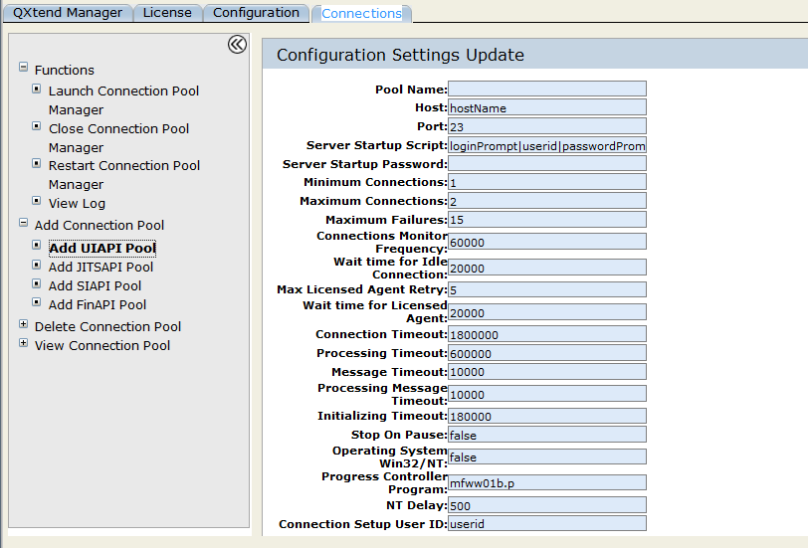
Add uiapi adapter

Slide 22
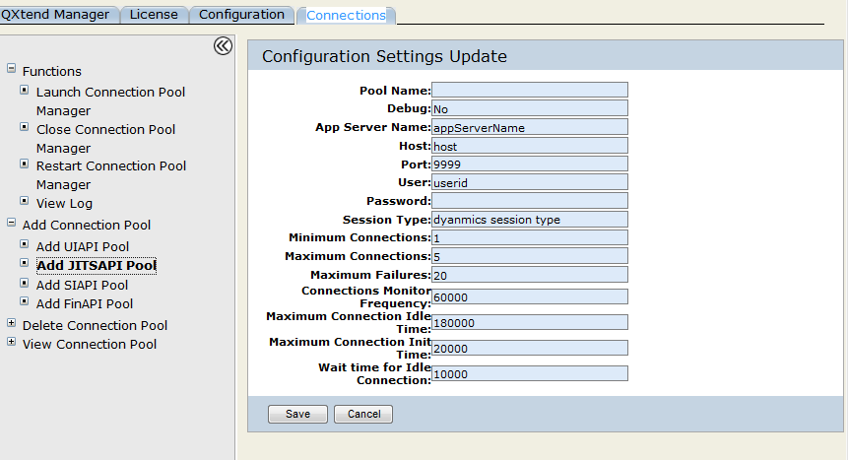
Add jitsapi pool

Slide 23
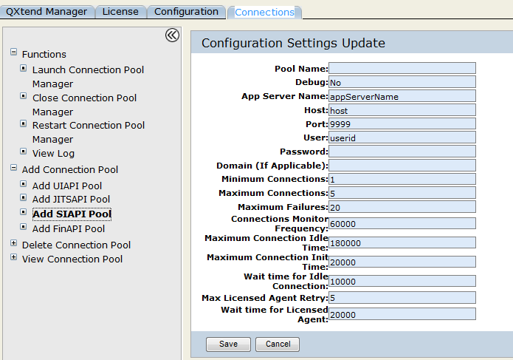
Add siapi pool

Slide 24
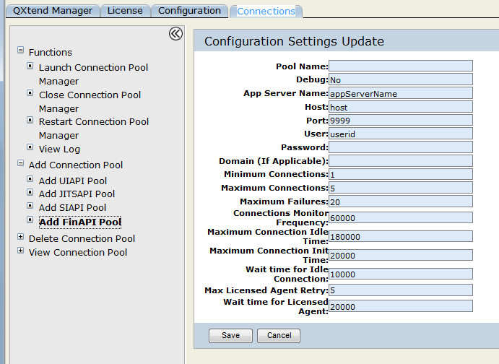
add finapi pool

Slide 25
Delete connection pool

Slide 26
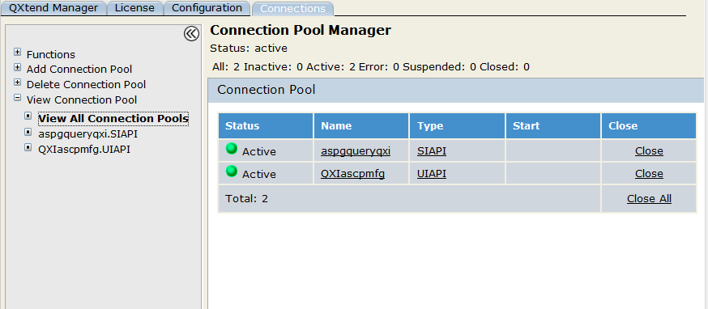
VIEW CONNECTION POOL

Slide 27
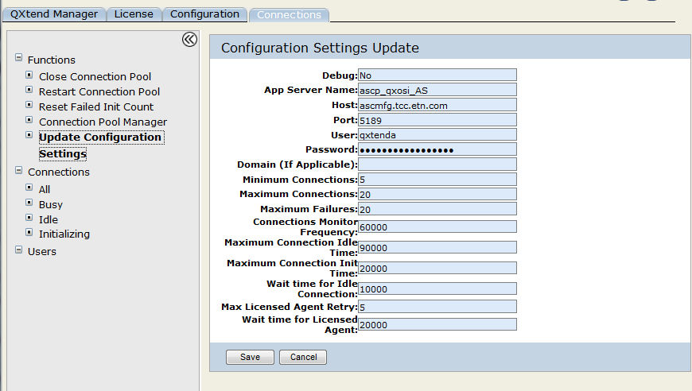
VIEW CONNECTION POOL

Slide 28
FUNCTIONS
Restart Server
Install Log
Test Harness
Suspend
Resume

Slide 29
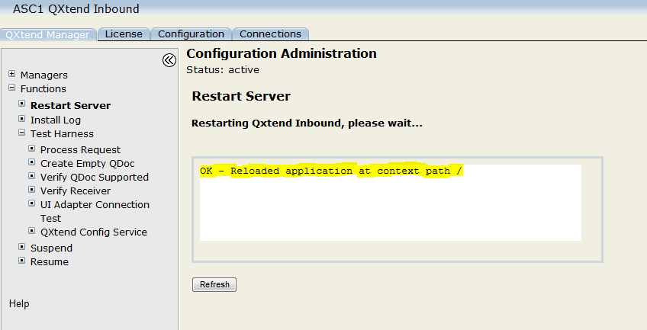
Restart Server
This shuts down QXtend Inbound and restarts it, using the Tomcat restart link.

Slide 30
Install Log
This displays qdocInstall.log. The log is updated each time the QXI Web application is started, stopped, or reloaded. The log is stored in:
TOMCAT_HOME/webapps/qxtendserver/WEB-INF/logs

Slide 31
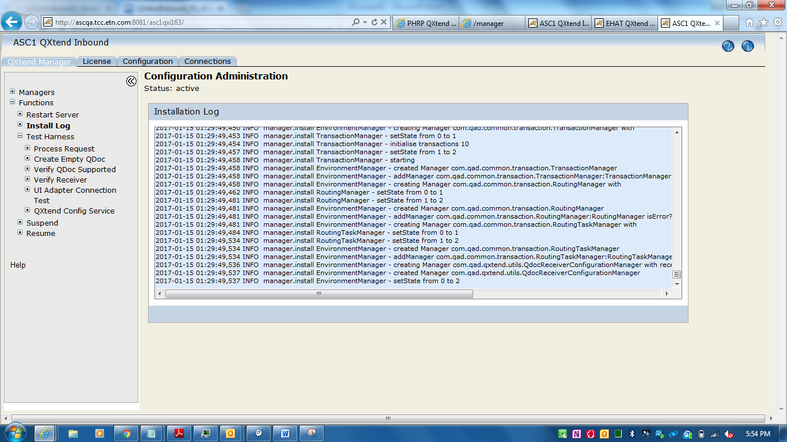
Install Log

Slide 32
Test Harness
The test harness provides an interface you can use to run through the entire request-response process using sample QDocs.
Under Test Harness :
Process Request
Create empty Qdoc
Verify Qdoc supported
Verify Receiver
UI Adapter connection test
Qxtend config service

Slide 33
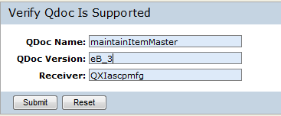
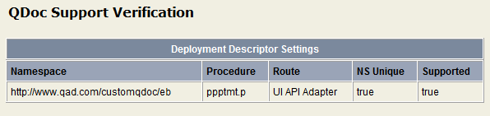
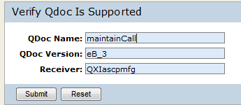

Verify QDoc supported
If Qdoc supported, then It gives all details.
Else shows unsupported.

Slide 34
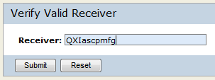

Verify Receiver
Enter receiver name and click submit

Slide 35
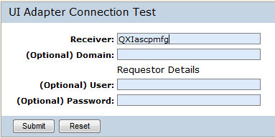
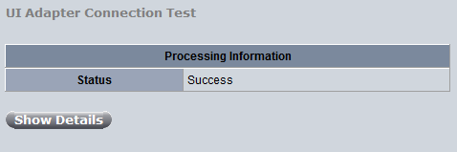
UI Adapter connection test
Enter receiver name

Slide 36
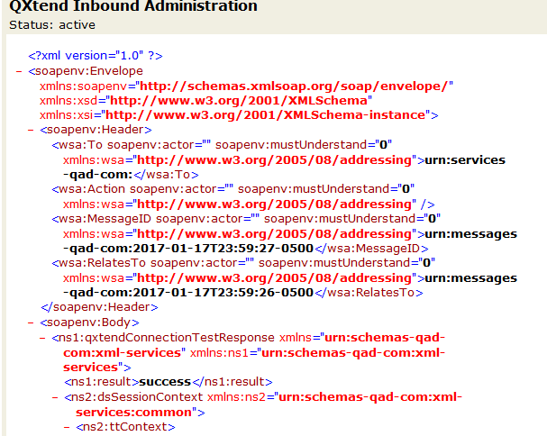
UI Adapter connection test
Clicking on show details

Slide 37
Suspend and resume
Suspend : This shuts down the QXtend services to allow an administrative update, such as configuration changes.
Resume : This restores QXI services following administrative changes.

